Slide 1
Section 2
2022-01-21

Slide 2
Note on git
Git commits ‘stack’ on top of one another
When submitting a commit, you submit the state of the repository after the commit
Don’t commit object files or compiled binaries!

Slide 3
Pointers and referencing/dereferencing
All variables have their own block of memory assigned to them
& allows us to retrieve the address of where a variable is stored - called referencing
* dereferences the value in the variable to read the value at the pointed memory address
The variable points to a memory address where the data is actually stored
As all function arguments are pass-by-value, for scanf to be able to assign values to our variables, we need to tell it the address of the variable, rather than its value
We will return to this after you have covered dynamic memory allocation

Slide 4
Arrays
Arrays in C are a block of variables of the same type together
We can access individual elements same as in python
arr[3] -> Access element at index 3
0 indexed

Slide 5
Markdown
.md files are markdown files - It is an easy way to quickly format a file to look nice
Here is a reference for it: https://www.markdownguide.org/basic-syntax/

Slide 6
Makefiles
Allow us to create rules for compiling and linking our program
We write these rules in a file called `Makefile` (note capitalization)
We use the `make` command to execute these rules

Slide 7
Structure of a Makefile
pig.o: pig.c names.h
clang -Wall -Wpedantic -Werror -Wextra -c pig.c
Orange: target
Green: prerequisites
Command is only run when prerequisite files have been updated
Purple: command(s)
Note: Indented using TAB
A prerequisite can be another target
The prerequisite target will be ran when needed
commands don’t necessarily need to be compilation commands
Prerequisites are not mandatory
Commands are not mandatory
pig: pig.o
clang -Wall -Werror -Wpedantic -Wextra -o pig pig.o
pig.o: pig.c names.h
clang -Wall -Wpedantic -Werror -Wextra -c pig.c
all: pig
pig: pig.o
clang -Wall -Werror -Wpedantic -Wextra -o pig pig.o
pig.o: pig.c names.h
clang -Wall -Wpedantic -Werror -Wextra -c pig.c
clean:
rm -f pig pig.o

Slide 8
Makefile variables
You can define variables in Makefiles
Help you avoid repeating commands/lists of files/lists of flags
You can even use variables to define targets and prerequisites
You can read more about wildcards, intrinsic rules, caveats, and best practices at this very good tutorial: https://makefiletutorial.com
I really recommend you scan through it, especially if you are having trouble with Makefiles
all: pig
pig: pig.o
clang -Wall -Werror -Wpedantic -Wextra -o pig pig.o
pig.o: pig.c names.h
clang -Wall -Wpedantic -Werror -Wextra -c pig.c
clean:
rm -f pig pig.o
CC = clang
CFLAGS = -Wall -Wpedantic -Werror -Wextra
all: pig
pig: pig.o
$(CC) $(CFLAGS) -o pig pig.o
pig.o: pig.c names.h
$(CC) $(CFLAGS) -c pig.c
clean:
rm -f pig pig.o

Slide 9
Running Makefiles
Run Makefiles using `make` command
make [ -f makefile ] [ options ] ... [ targets ] ...
E.g.
make pig.o
make pig
make all
make clean
For more information: `man make`
Note: this is a terminal utility, so you want section 1 of the manual

Slide 10
Random function
Numbers returned by random are only pseudo-random
The sequence is repeatable, if you know the seed
We set the seed using srandom
Modulo (%) operator
Returns the remainder of a division
E.g.
5 % 3 = 2
21 % 7 = 0
Changing range from 0 to RAND_MAX:
min + (random() % (max - min))

Slide 11
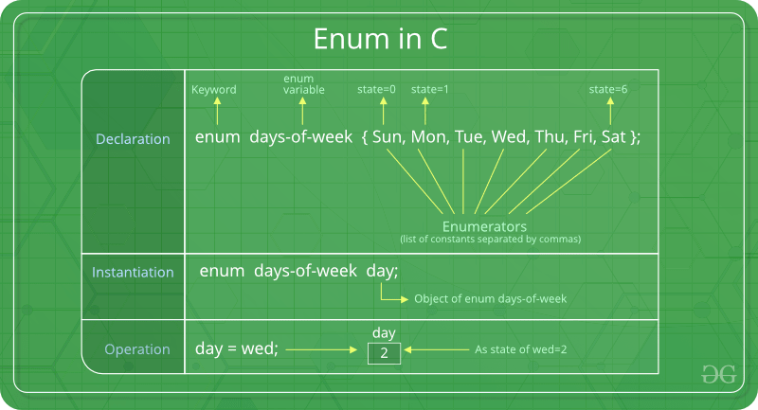
Enum and typedef
Source: https://www.geeksforgeeks.org/enumeration-enum-c/

Slide 12
The random functions
What are the options, how do they work?
Use man 3 random
SYNOPSIS
#include <stdlib.h>
long int random(void);
void srandom(unsigned int seed);
[...]
DESCRIPTION
The random() function uses a nonlinear additive feedback random number generator employing a default table of size 31 long integers to return suc-
cessive pseudo-random numbers in the range from 0 to RAND_MAX. The period of this random number generator is very large, approximately
16 * ((2^31) - 1).
The srandom() function sets its argument as the seed for a new sequence of pseudo-random integers to be returned by random(). These sequences are
repeatable by calling srandom() with the same seed value. If no seed value is provided, the random() function is automatically seeded with a value
of 1.
[...]
RETURN VALUE
The random() function returns a value between 0 and RAND_MAX. The srandom() function returns no value.
[...]

Slide 13
enum
Essentially just integers under the hood
Allows us to avoid “magic numbers”

